Slide 1
FAIRagro – in a nutshell and first results
Markus Möller on behalf of the FAIRagro Konsortium

Slide 2
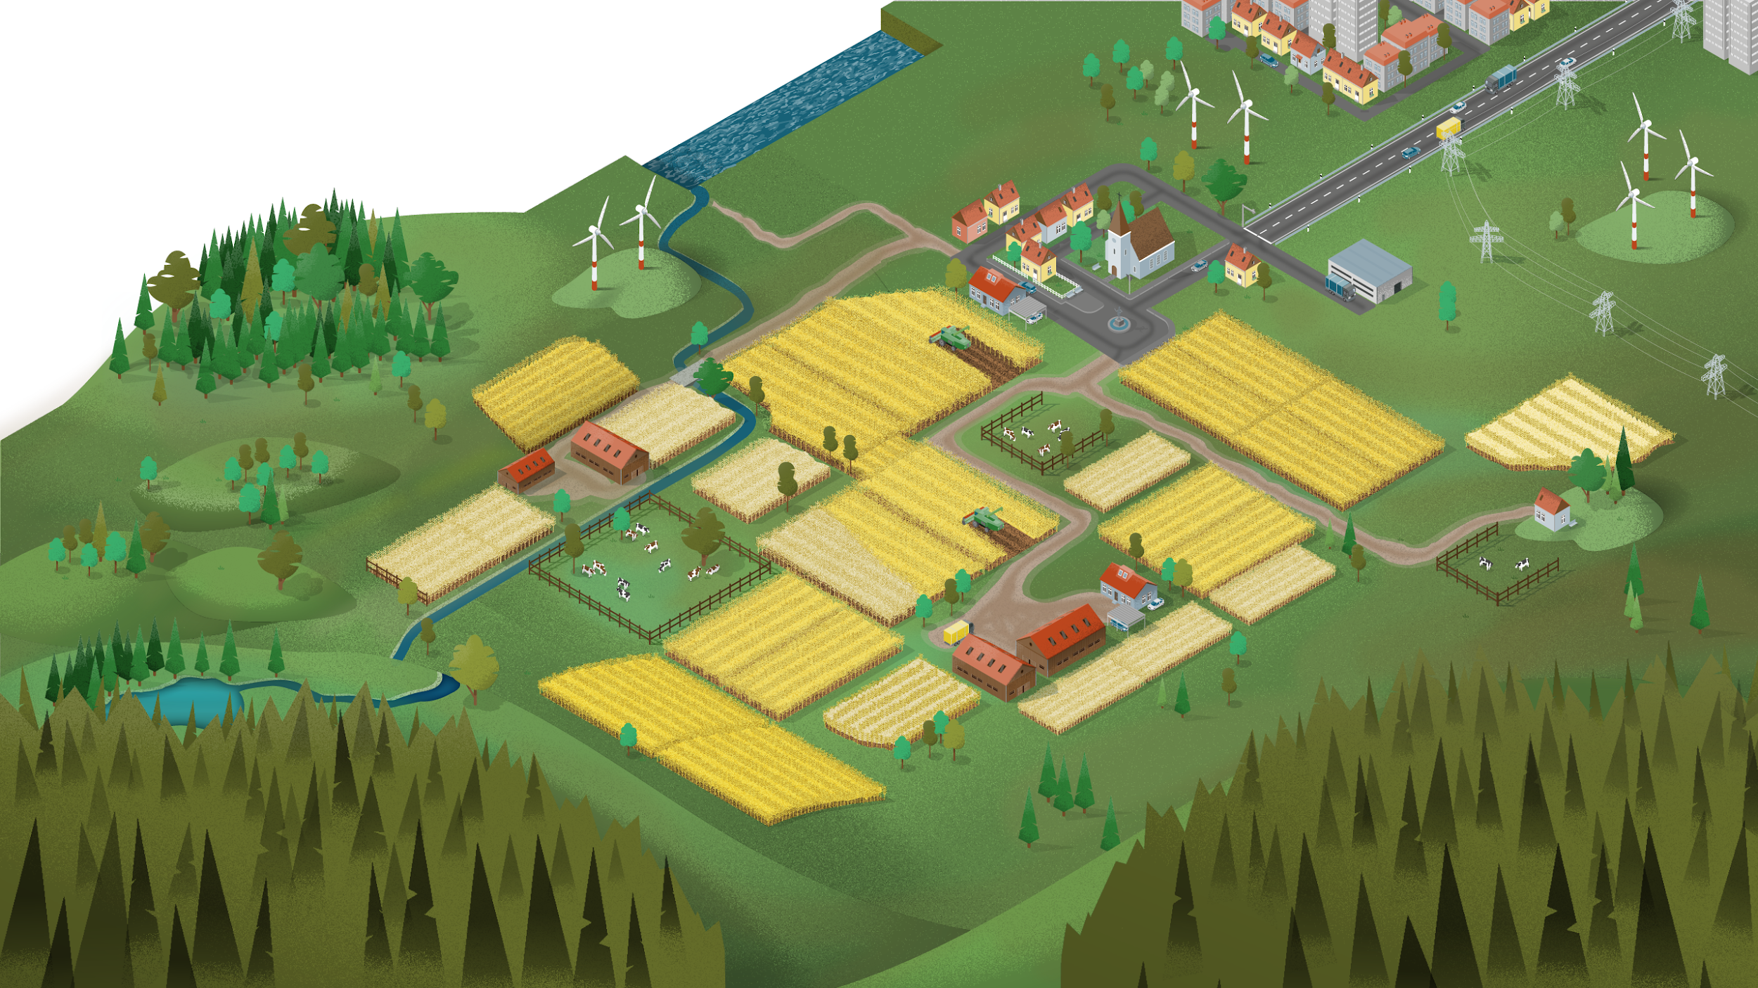





FAIRagro domain: scales, disciplines and data categories
→ Start 1.3.2023
FAIR data for agrosystem research: Crop production, ecosystems and landscapes whose sustainable management and development are based on systems understanding of plant-soil-environment interactions, taking into account cross-scale processes and relationships
Scales
Data categories
Subjects and disciplines
…
Plant
time-series
geo data
Region
Landscape
Farming 4.0
sensitive data
Farm field
Environment
Soil
Crop trial
legacy data
omics data
Plants
Genes
…

Slide 3
Our partners: leading institutions in the agrosystem domain
11 (Co-)applicants + 19 participants
Universities
Universities of applied sciences
Research institutes
Federal (research) institutes
Infrastructure facilities
Governmental institutions
Professional scientific associations
Representing important disciplines in
Crop and vegetable sciences
Soil sciences
Agri-environmental sciences
Socio-economics

Slide 4


FAIRagro helpdesk https://fairagro.net/helpdesk/
Use cases
Data Steward Service Center
FAIRagro
Services
UC1
Breeding
H
E
L
P
D
E
S
K
Networked
RDIs
UC2
Agronomy
Coordinator
Data Stewards
Search & Inventory
UC3
Pest &
disease
Combining expertises in DMP, training, education, MIAPPE, copyright, licenses, DOI, spatial data, farming 4.0 data, data quality, long-term preservation, ...
Agrosystem community
Scientific Workflow Infrastructure
UC4
LTE
UC5
Sensor
systems
…
UC6
Integrated
modeling
info@fairagro.net | Toolbox for publishing and managing research data

Slide 5
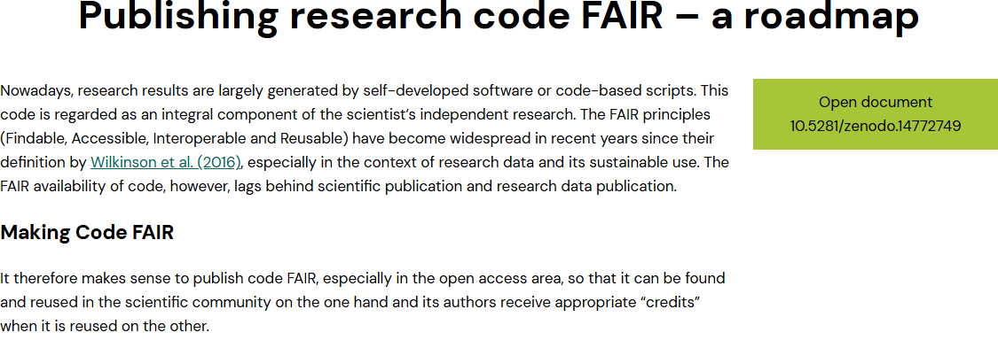
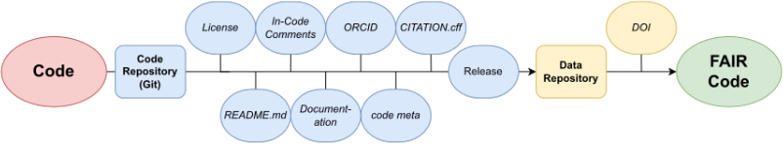
FAIRagro helpdesk https://fairagro.net/helpdesk/

Slide 6
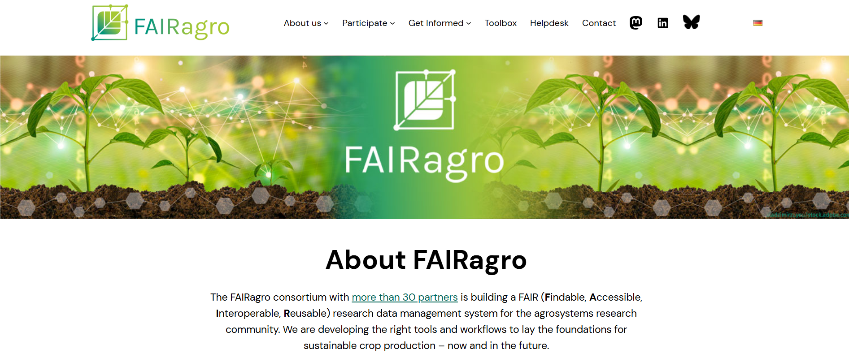
https://fairagro.net

Slide 7
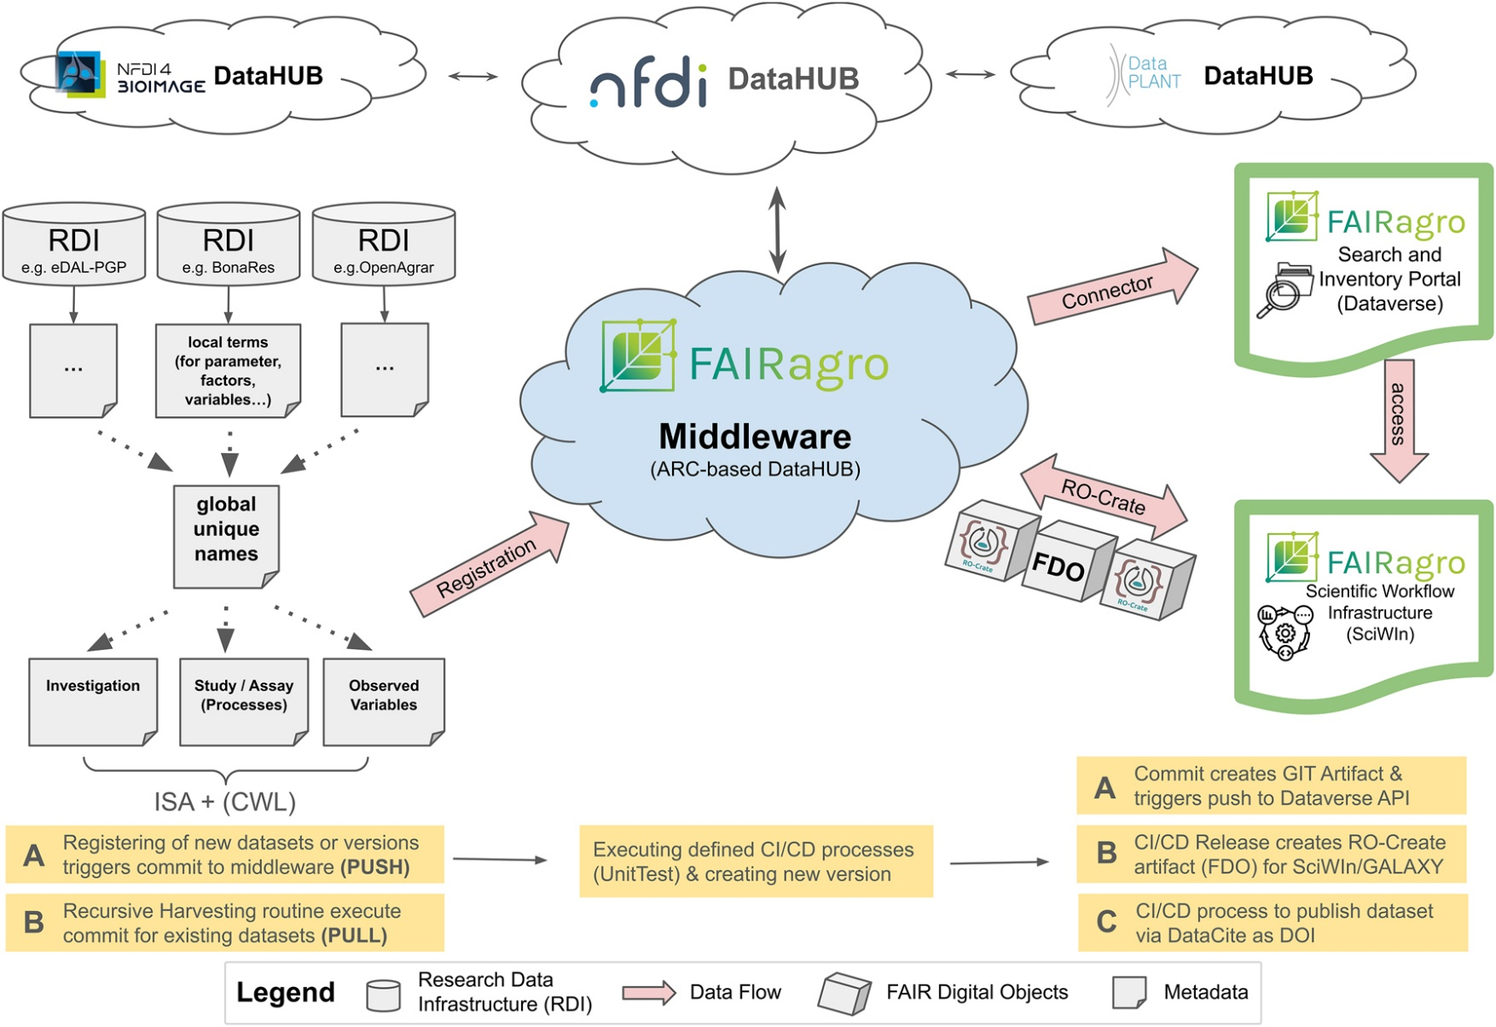
FAIRagro infrastructure: middleware
The central component of the extended middleware is an ARC-based GitLab infrastructure, which will be used to register all public datasets provided by the FAIRagro RDIs.
FDO – Fair Digital Objects -> Provenance Run Crates -> Annotated Research Contexts (ARCs)
García Brizuela, J., Scharfenberg, C., Scheuner, C., Hoedt, F., König, P., Kranz, A., Leidel, A., Martini, D., Schneider, G., Schneider, J., Singson, L.S., Von Waldow, H., Wehrmeyer, N., Usadel, B., Lesch, S., Specka, X., Lange, M., Arend, D., 2024. A roadmap for a middleware as a federation service for integrative data retrieval of agricultural data. Journal of Integrative Bioinformatics 21, 20240027. https://doi.org/10.1515/jib-2024-0027

Slide 8
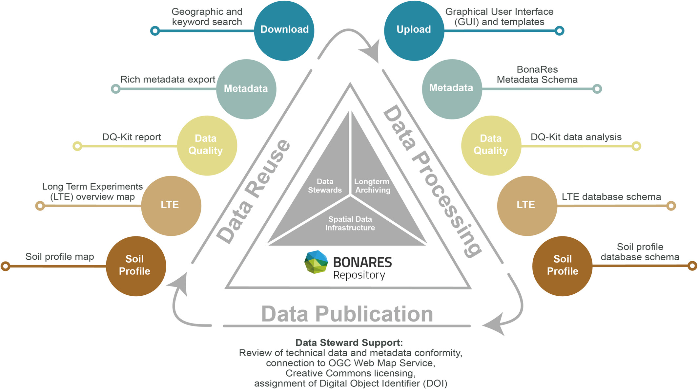
FAIRagro infrastructure: BONARES repository
Core (grey) and discipline-specific (coloured circles) infrastructures and services of the BonaRes Repository
Lachmuth, S., Dönmez, C., Hoffmann, C., Specka, X., Svoboda, N., Helming, K., 2025. Facilitating Effective Reuse of Soil Research Data: The BonaRes Repository. European J Soil Science 76, e70103. https://doi.org/10.1111/ejss.70103

Slide 9
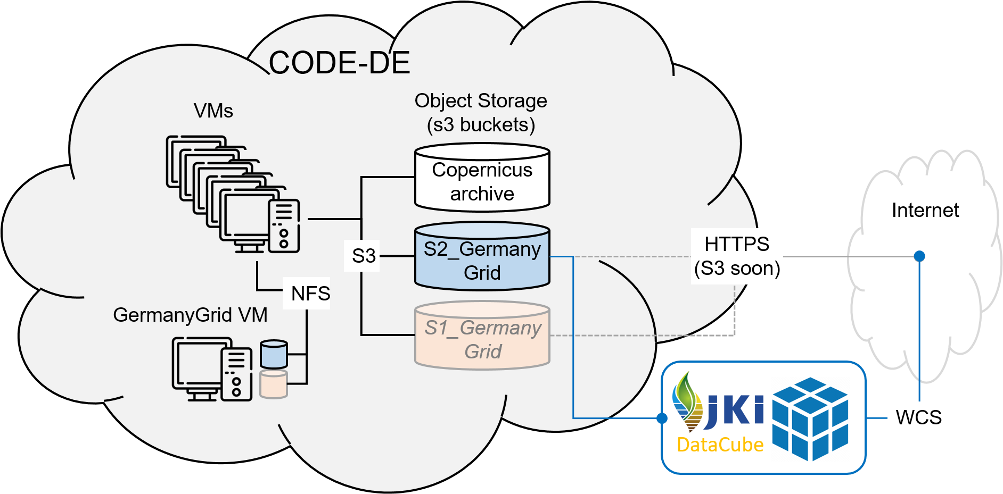
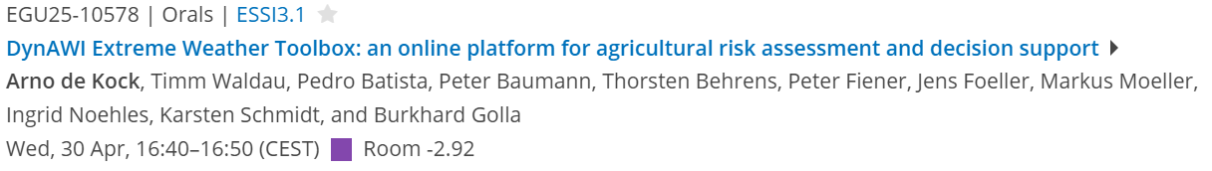
FAIRagro infrastructure: JKI Data Cube
FAIR processes
Jupyter Notebook WC(P)S demo of JKI Data Cubes
Beyer, F., Möller, M., Dierks, M.,2024. JKIDataCubeDemo. Zenodo. https://doi.org/10.5281/zenodo.14215012
FAIR multidimensional data
OpenAPI WCS documentation
https://sf.julius-kuehn.de/openapi/weather/
https://sf.julius-kuehn.de/openapi/S2_GermanyGrid_JKI/
https://sf.julius-kuehn.de/openapi/phase/
Beyer, F., Brandt, P., Schmidt, M., König, S., Stahl, U., Baumann, P., Golla, B., Gerighausen, H., Möller, M.,. Big geodata and spatial data infrastructures: A perspective of a German authority. under review in PFG – Journal of Photogrammetry, Remote Sensing and Geoinformation Science

Slide 10
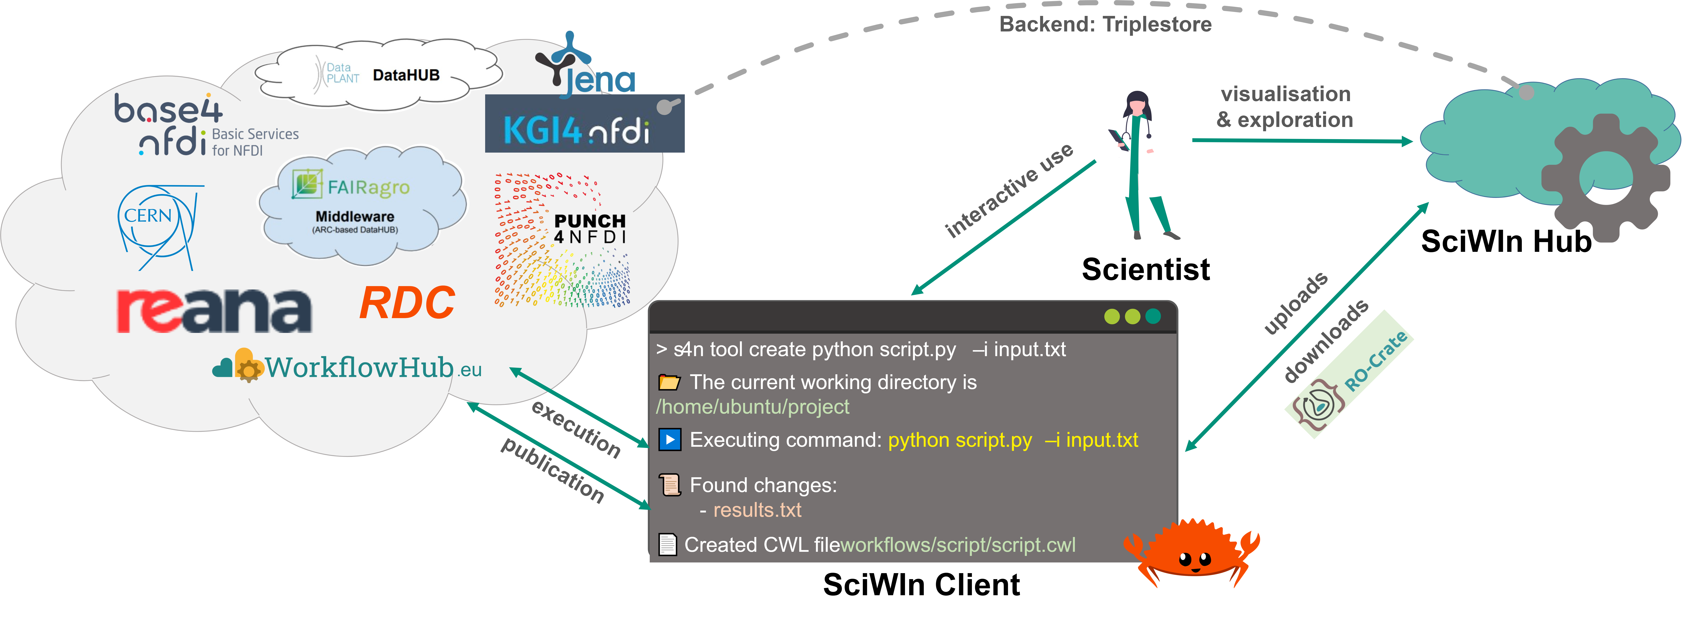
FAIRagro infrastructure: SciWIn client
Leidel et al. (2024). https://doi.org/10.5281/zenodo.11619214
https://github.com/fairagro/m4.4_sciwin_client
Computational workflows are essential for ensuring reproducibility, scalability, and efficiency in scientific research. The FAIRagro Scientific Workflow Infrastructure (SciWIn) supports scientists to create, execute, share, and publish these workflows, fostering collaboration and transparency.

Slide 11
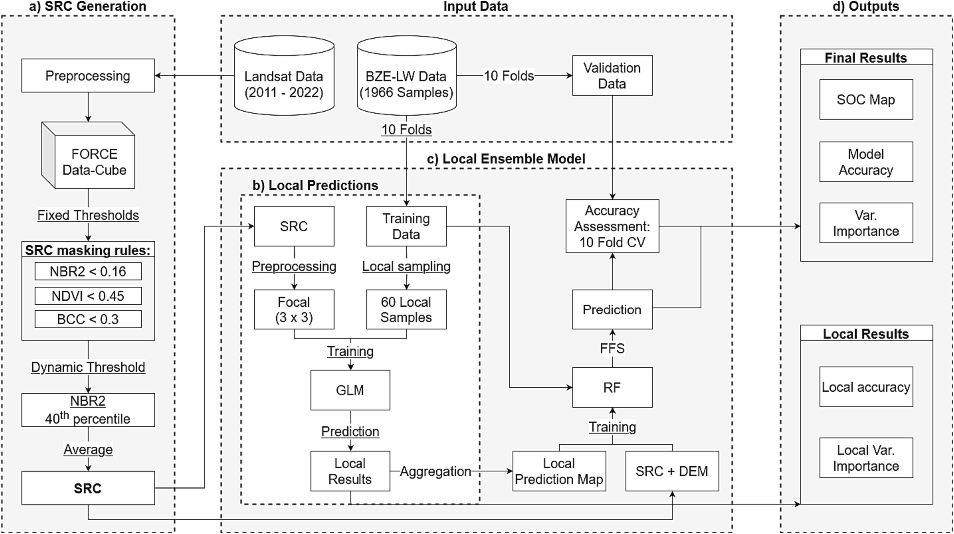
FAIRagro infrastructure: SciWIn client
Broeg, T., Don, A., Gocht, A., Scholten, T., Taghizadeh-Mehrjardi, R., Erasmi, S., 2024. Using local ensemble models and Landsat bare soil composites for large-scale soil organic carbon maps in cropland. Geoderma 444, 116850. https://doi.org/10.1016/j.geoderma.2024.116850
11

Slide 12
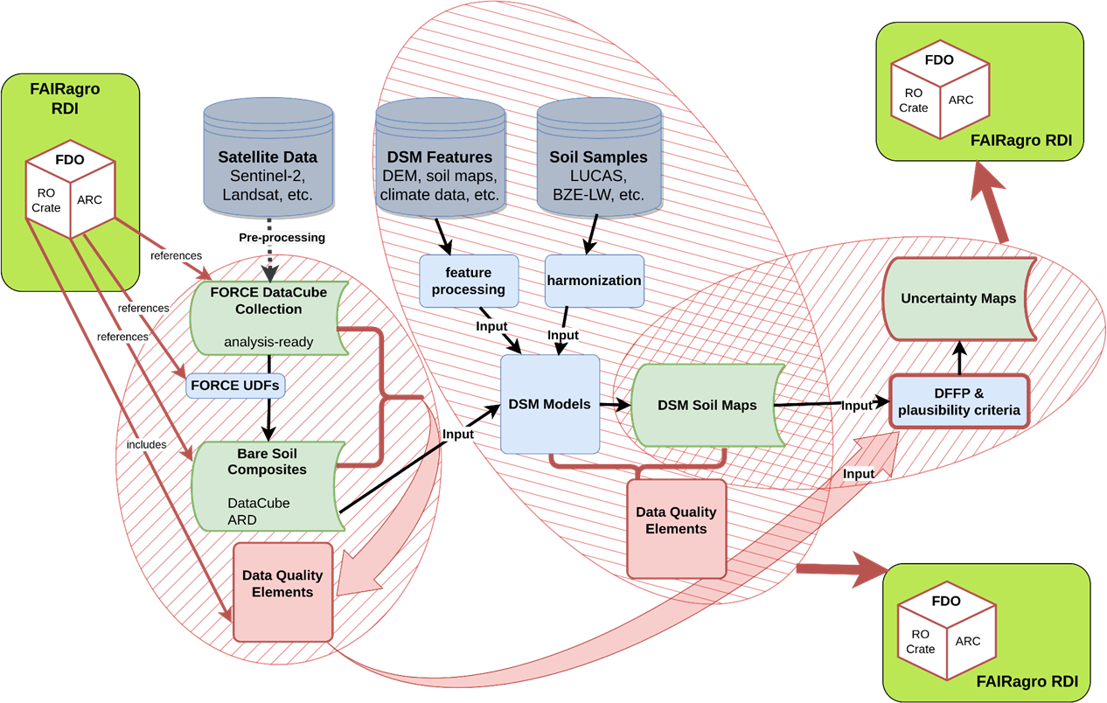
FAIRagro infrastructure: SciWIn client
ReUseDSM: Boosting the re-usability of Digital Soil Mapping products: A blueprint for the reproducible creation of FAIR data-quality information
Scientific Workflow Infrastructure
(SciWin) Client
RDI - FAIRagro-connected research data infrastructure
DSM – Digital Soil Mapping
FDO – Fair Digital Objects -> Provenance Run Crates -> Annotated Research Contexts (ARCs)
12

Slide 13
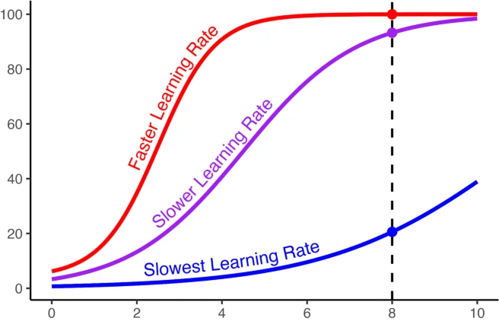
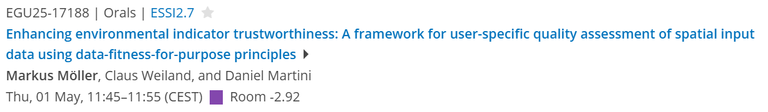
FAIRagro: Shortening the FAIR learning curve
Tools
Best Practice Examples
…
FAIR data description
Numbers of hours spent learning to be FAIR
Schuetze, B.A., 2024. A Computational Model of School Achievement. Educ Psychol Rev 36, 18 (2024). https://doi.org/10.1007/s10648-024-09853-6

